Slide 1
Stickerbook: A New Impartial Game
Chase Pittman
Emily Deker

Slide 2
How to Play Stickerbook
Stickerbook is an original game developed by Chase Pittman and Emily Deker. Stickerbook is played on an m x n grid where m,n ≥ 2. Players take turns placing square “stickers” over squares on the board, placing a single sticker on any uncovered spot during their turn. The first player to place a sticker such that a 2 x 2 solid square is formed loses the game.
X
First Player (Red Stickers) Wins!

Slide 3


How to Play Stickerbook
X
Not an mxn board!
Second Player (Yellow Stickers) Wins!

Slide 4
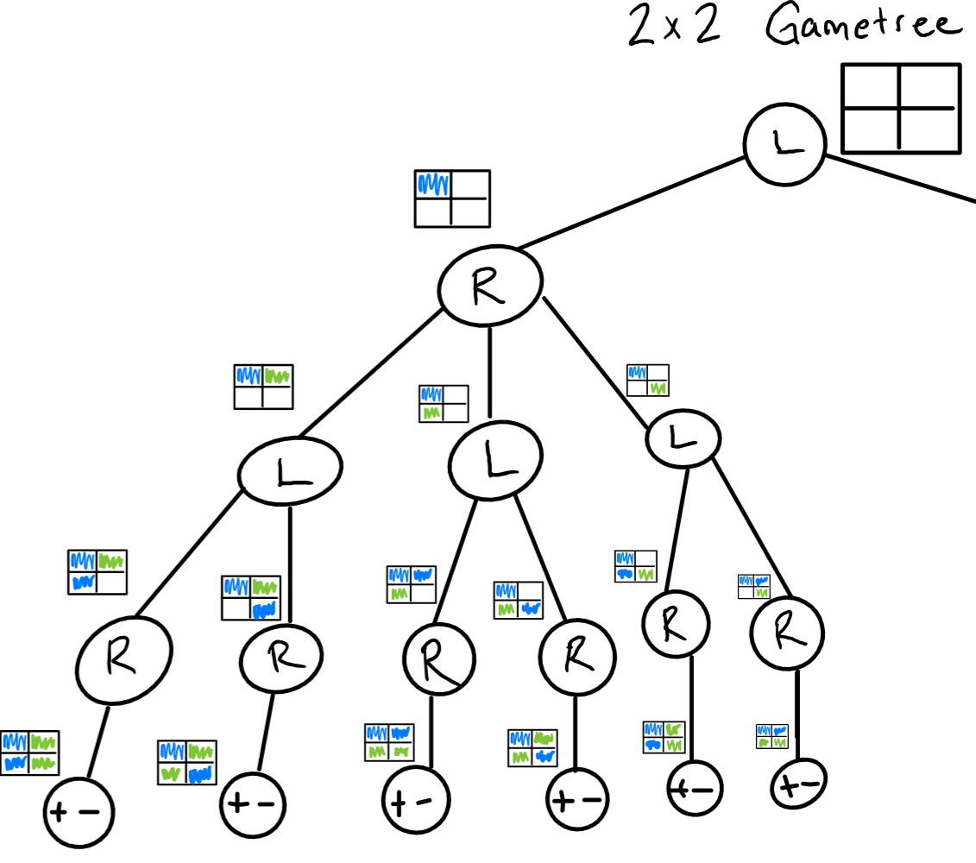
How to Win Stickerbook
2x3 Game Board
2x2 Game Board
Type N
Type N

Slide 5
How to Win Stickerbook
3x3 Game Board
Type N
4x5 Game Board
4x4 Game Board
Type P
Type P

Slide 6
Nimbers
Sprague-Grundy Theorem: Every position in an impartial game is equivalent to a certain position in the game nim.
*0
*1
*0
*1
Notes:
Say type at end due to nimbers

Slide 7
Nimbers
*2
*3
*1

Slide 8
Nimbers
*2

Slide 9
Theorem: Any 4xn board is type P for all n ≥ 2.
a1
a1
b1
Divide the board into two 2xn rows. Assign every block on the top row a unique label, and repeat this labelling on the bottom row.
The first player will choose some block to play in on the first turn. The second player should then play in the block of the same label on the opposite row.
The second player will always be able to follow this strategy, as every position has a single paired position on the opposite row.
The second player will never be forced to play a losing move, as doing so would require that losing move to first be played by the first player.
b1
c1
d1
d1
e1
f1
f1
g1
h1
g1
h1
a2
a2
a2
b2
b2
c2
d2
d2
d2
e2
f2
f2
g2
g2
h2
h2

Slide 10
Theorem: All square nxn boards are type N if n is odd.
1,1
Assign coordinates to each block on the board based on its position relative to the central block.
For every block at (m,n) claimed by the second player, the first player should play in the coordinate (-m,-n).
For every (m,n) there exists a corresponding (-m,-n). As the only block where (m,n) = (-m,-n) is (0,0).
All moves made by the first player are reflections of moves made by the second player, and so an illegal move made by the first player was first made by the second player, which would result in a loss for the second player.
-1,1
1,1
-1,1
0,1
1,0
-1,0
0,0
1,0
-1,0
0,0
1,-1
a2
1,-1
-1,-1
-1,-1
0,-1

Slide 11
Questions for the Future
We are currently working on typing 2xn boards.
Can we modify Stickerbook to make analysis easier?

